Slide 1
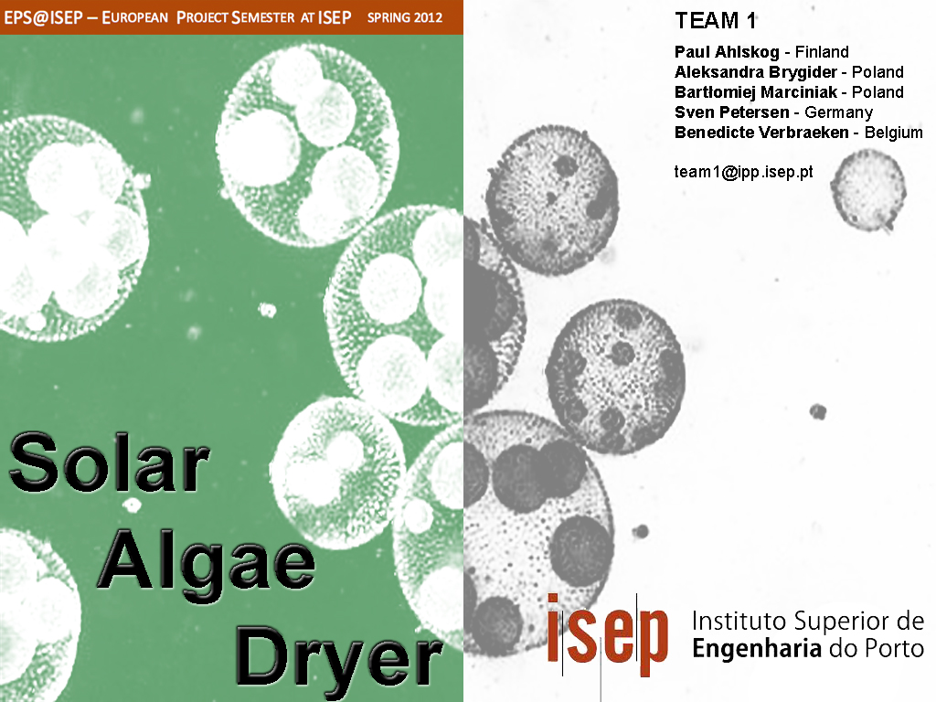

Slide 2
Contents
Problem
Objectives
State of the art
Project development
Results
Future perspectives
Conclusions
Demo
References

Slide 3

Problem
Drying algae with the use of solar power
Diminish energy usage

Slide 4

Objectives
Building prototype suitable for future tests
Incorporating control process (not to damage algae)

Slide 5
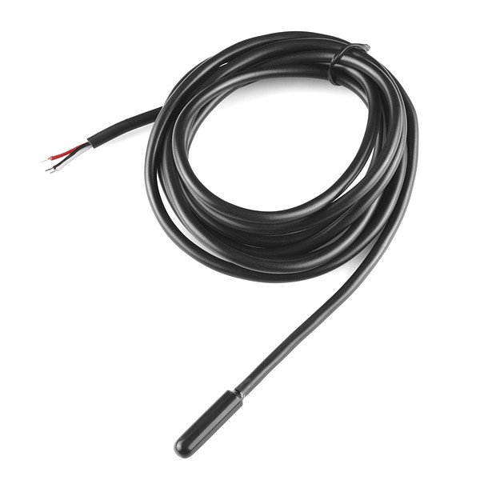
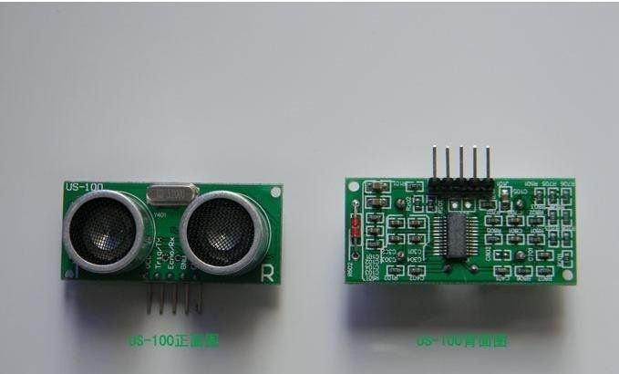
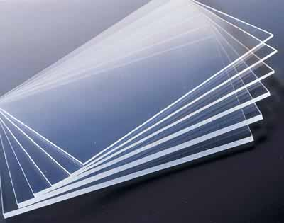
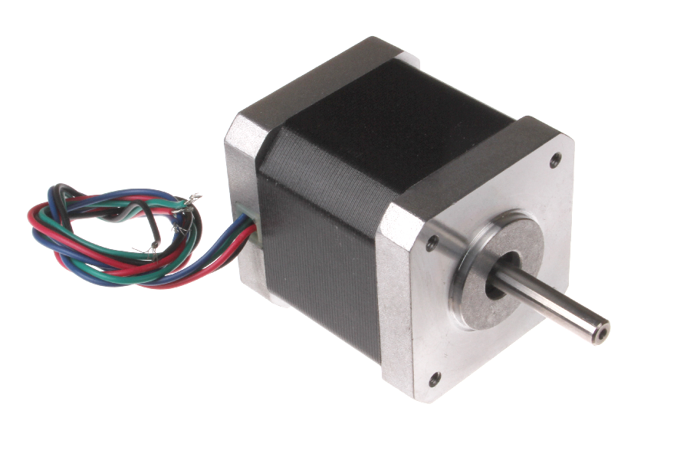
State of the art

Slide 6
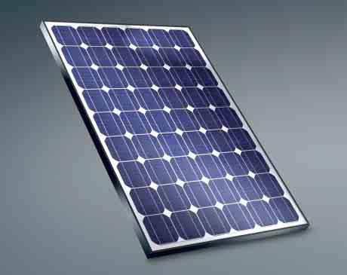
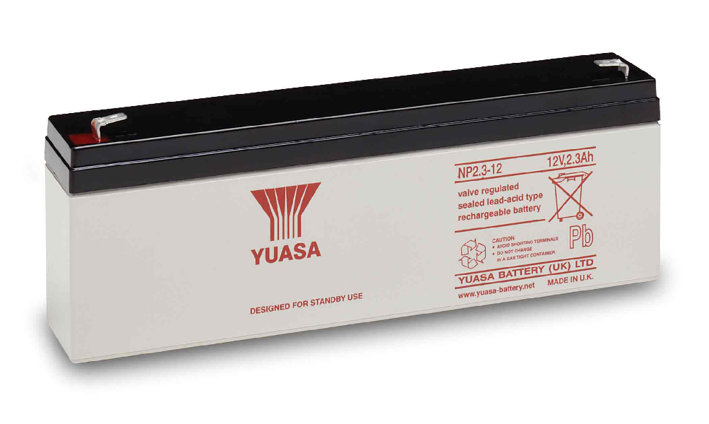
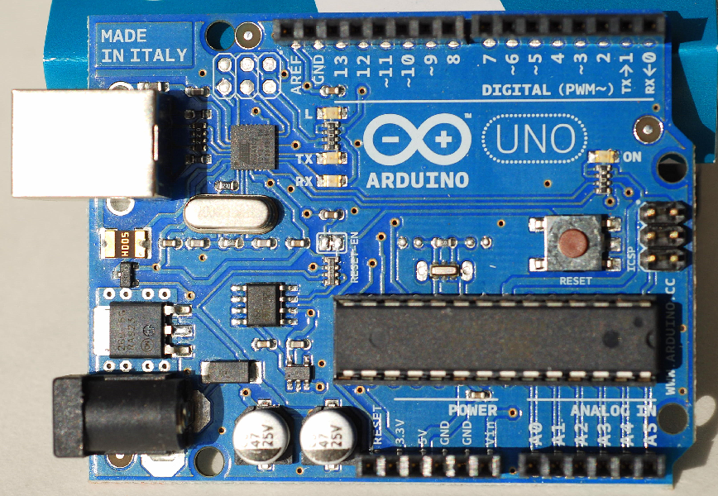
State of the art

Slide 7
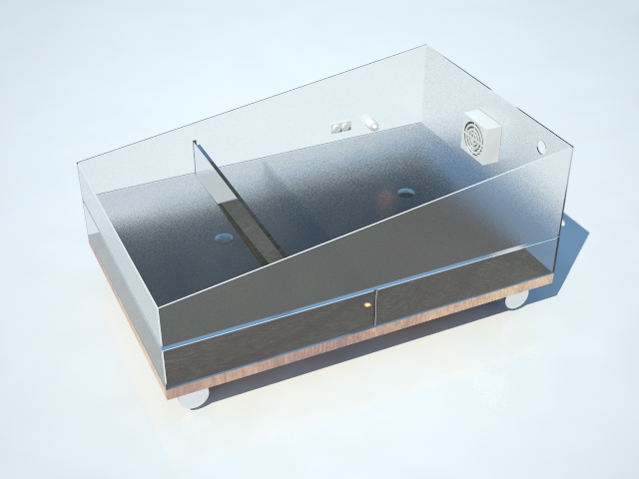
Project development

Slide 8
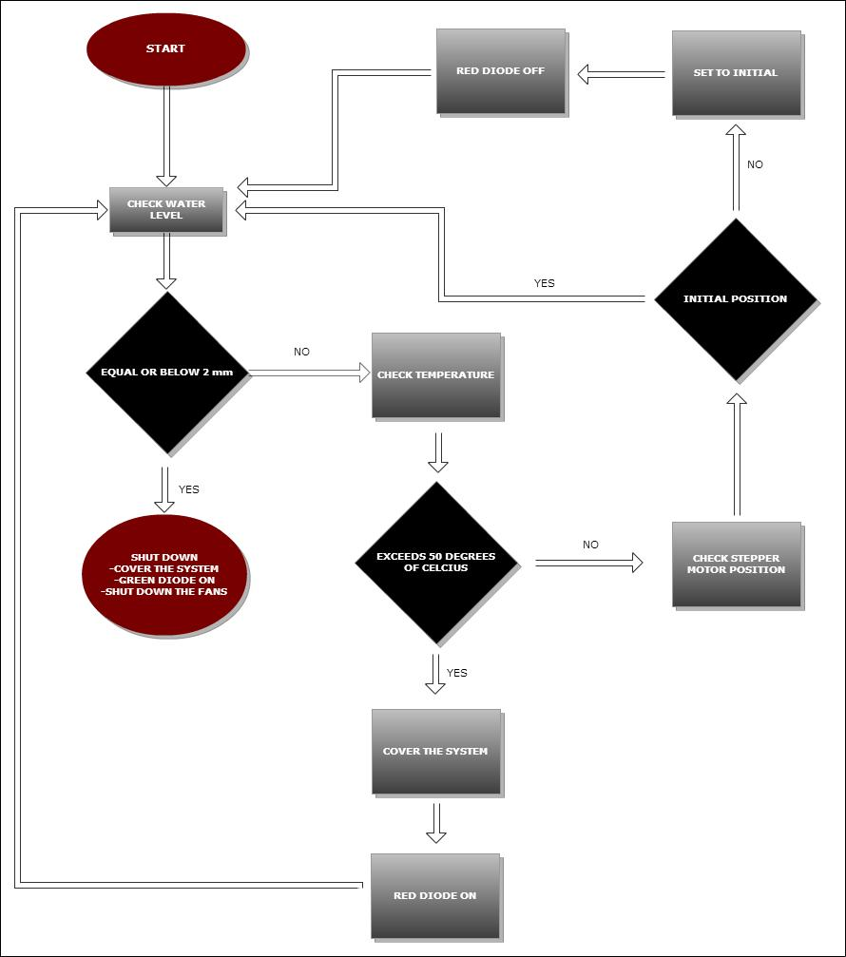
Project development

Slide 9
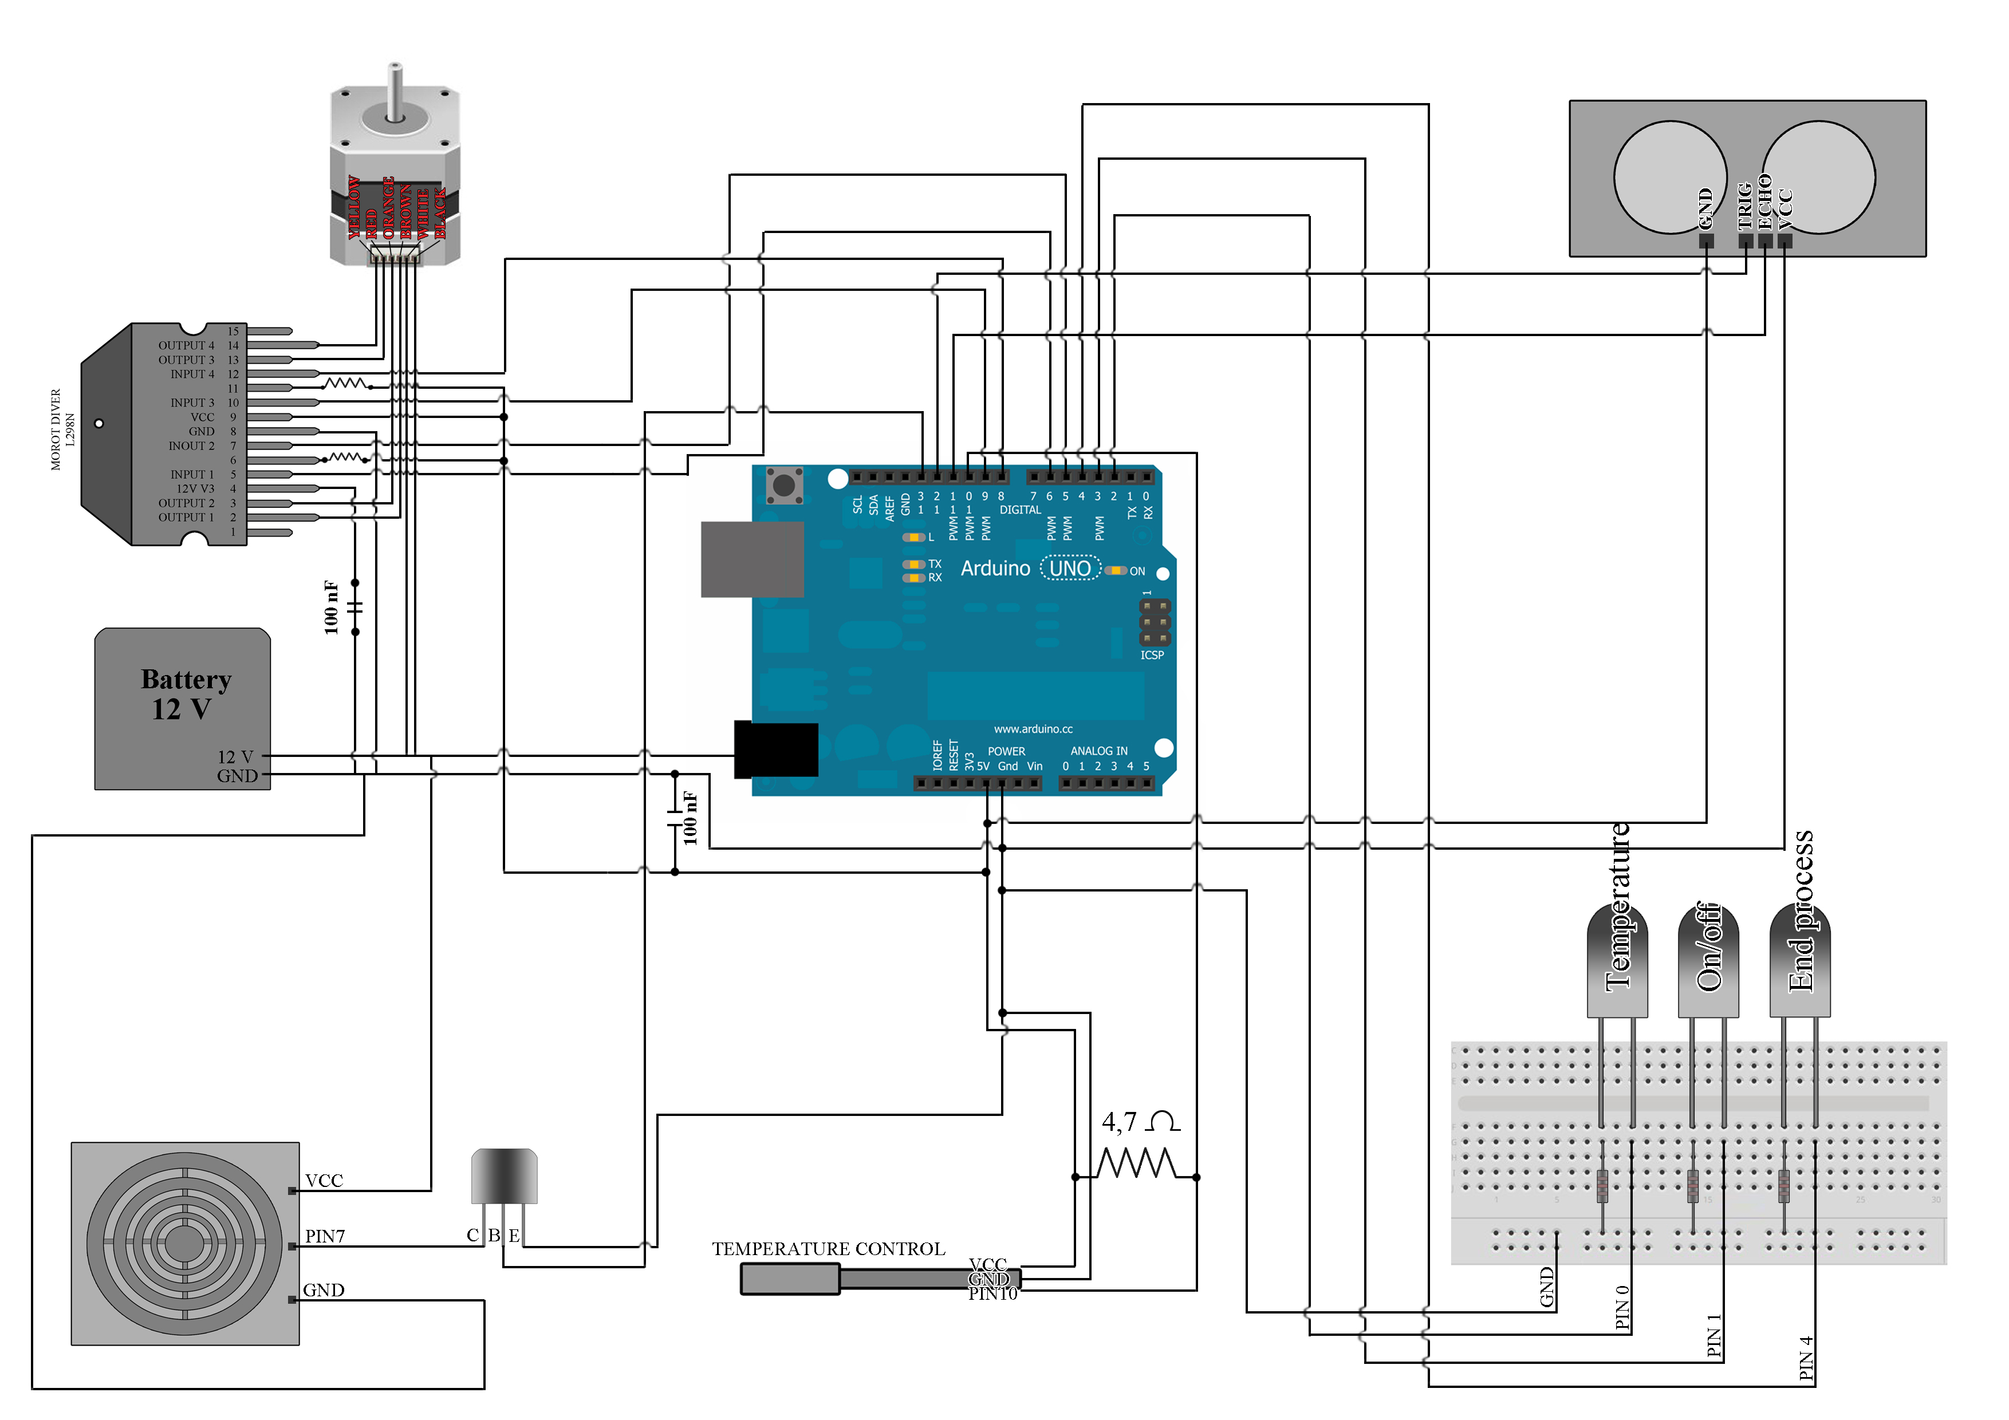
Project development

Slide 10
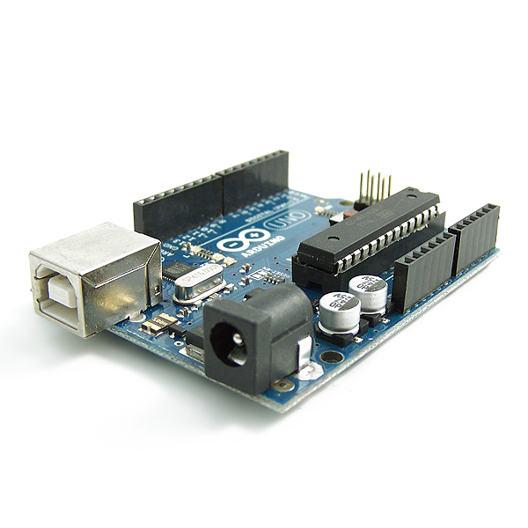


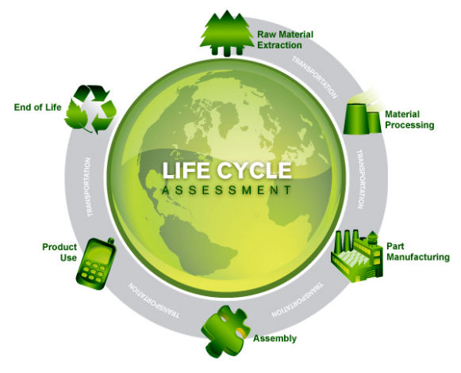
Results
Prototype built ✓
Electronic devices programmed ✓
Project follows marketing,sustainability and ethical assumptions ✓

Slide 11
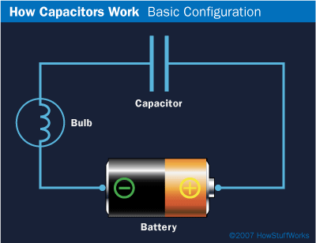
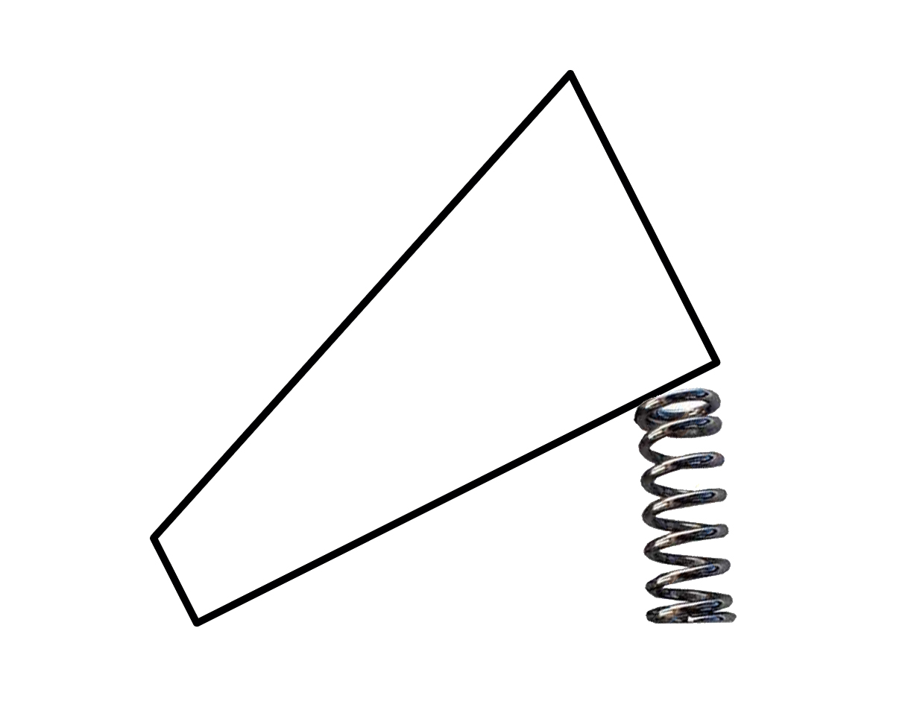


Future perspectives
Charging the algae:
Capacitor
Mechanical solution
Water recovery system
Bio diesel

Slide 12
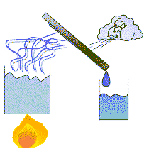


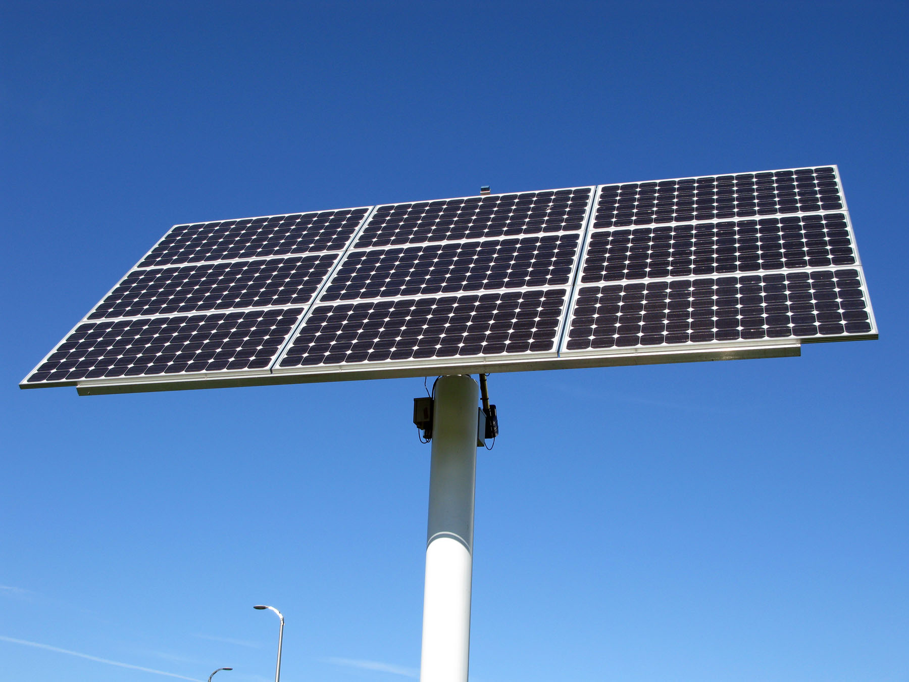
Conclusions
Lower power consumption
Power tank ->
Power parts ->

Slide 13

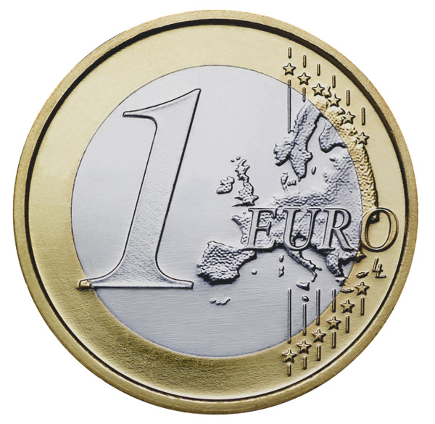
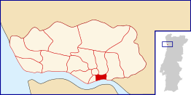

Conclusions
Parts:
=> Source:
  Local suppliers
  School

Slide 14
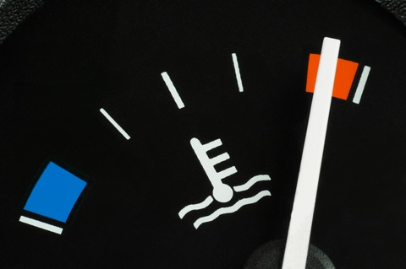

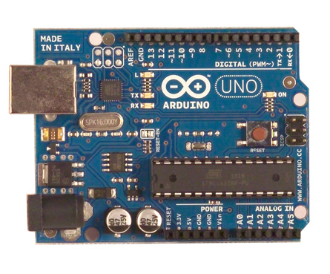
Conclusions
Functions:
  Not overheating
  Alarm: end process
  Arduino
Ethics, marketing
and sustainability

Slide 15
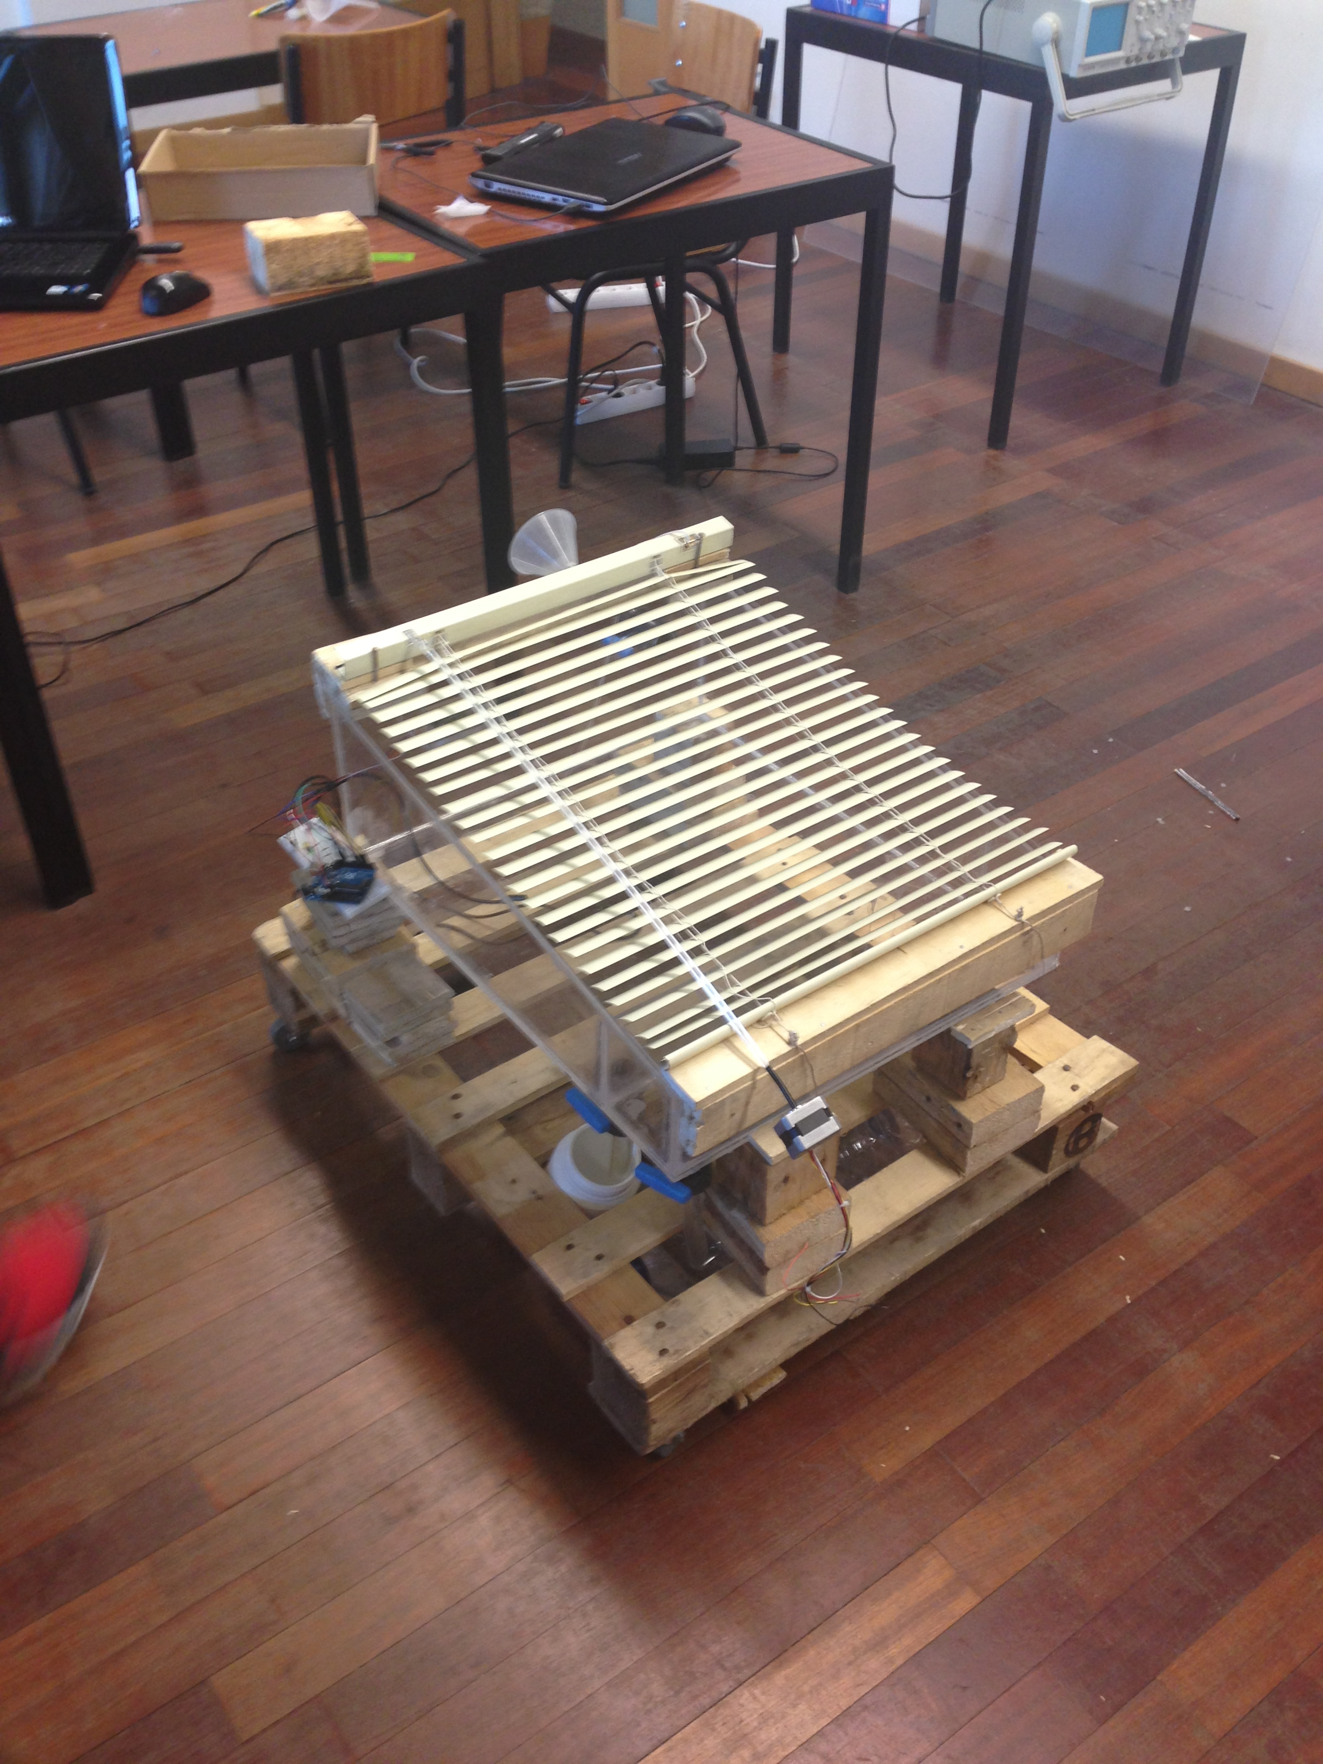
DEMO

Slide 16
References
http://image.made-in-china.com/2f0j00vZkEaowqAfcB/Color-LED-Plexiglass-Sheet.jpg
http://upload.wikimedia.org/wikipedia/commons/8/83/Nema_17_Stepper_Motor.jpg
http://i00.i.aliimg.com/img/pb/314/013/455/455013314_909.jpg
http://cdn2.bigcommerce.com/server500/810ec/products/2643/images/15574/11050-04__59142__56279.1368471949.1280.1280.jpg
http://www.msbs.net/portals/0/images/MonocrystallineSolarPanel.jpg
http://hifiduino.files.wordpress.com/2010/09/dsc_53861.jpg

Slide 17


